Slide 1
Power Analysis: Determining Sample Size for Quantitative Studies
October 28, 2020

Slide 2
Presentation Overview
Why is sample size important?
What is statistical power? What is a power analysis?
Basics of G*Power
Power analysis examples
Sample size calculation for advanced analyses
Questions

Slide 3
Why is sample size important?
The ability to find statistically significant results depends on sample size.
Higher sample size = greater chance that results will be significant
Lower sample size = lower chance that results will be significant
Increasing your sample size will increase the “sensitivity” of your statistical test.
If you do not have a large enough sample, important effects/differences may go undetected.

Slide 4
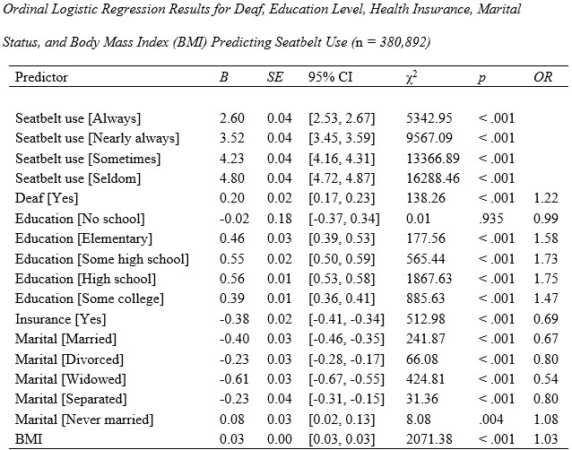
Why is sample size important?
Can your sample size be too large?

Slide 5
Why is sample size important?

Slide 6
What is statistical power?
Statistical power is the probability of finding a statistically significant effect in the sample if the effect actually exists in the population.
Power = 1 – Type II error rate
Type II error: Failing to detect an effect that actually exists (false negative)
Standard for statistical power is .80
We want to have at least an 80% chance of finding statistical significance if the effect/difference does, indeed, exist.

Slide 7
What is a power analysis?
A power analysis is an objective way to determine the appropriate sample size for a statistical analysis.
The appropriate sample size is calculated based on:
Type of analysis being conducted
Expected/hypothesized effect size
Significance (alpha) level (e.g., .05)
Power level (e.g., .80)
A priori vs. post hoc power analysis
Software packages are available for conducting power analysis (e.g., G*Power).

Slide 8
Power Analysis Software: G*Power
https://www.psychologie.hhu.de/arbeitsgruppen/allgemeine-psychologie-und-arbeitspsychologie/gpower.html

Slide 9
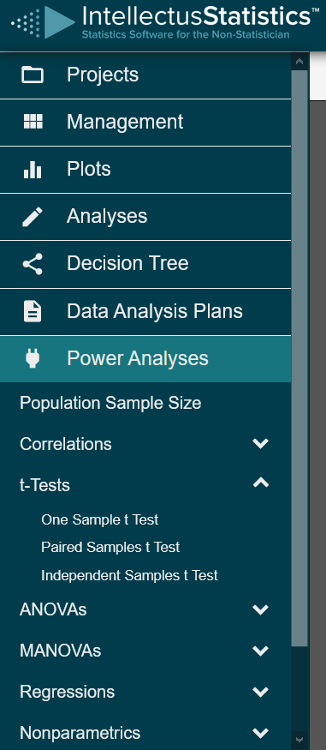
Power Analysis Software: Intellectus Statistics
https://analyze.intellectusstatistics.com

Slide 10
Example: t-tests

Slide 11
Example: Analysis of Variance (ANOVA)

Slide 12
Example: Regression

Slide 13
Advanced Analyses
What if the type of analysis I am doing is not in G*Power?
Factor analysis
Structural equation modeling
“Rules of thumb” (participant to variable ratio)
Simulation studies (Monte Carlo analysis)
Wolf, E. J., Harrington, K. M., Clark, S. L., & Miller, M. W. (2013). Sample size requirements for structural equation models: An evaluation of power, bias, and solution propriety. Educational and psychological measurement, 73(6), 913-934.

Slide 14
Interested in additional help?
Schedule a consultation to learn more about what we offer:
https://app.hubspot.com/meetings/jeanine/dissertation-consultation

Slide 15
Questions?

